Slide 1
DoS Attack Detection using Machine Learning
Minor Project By:
Rajpurohit Bhavani Singh
(A217131522045)

Slide 2
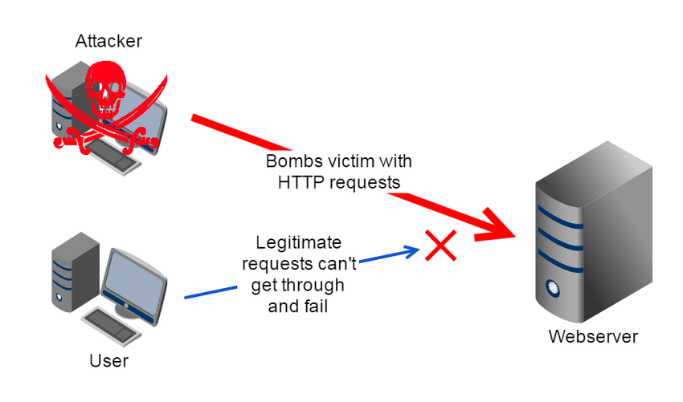
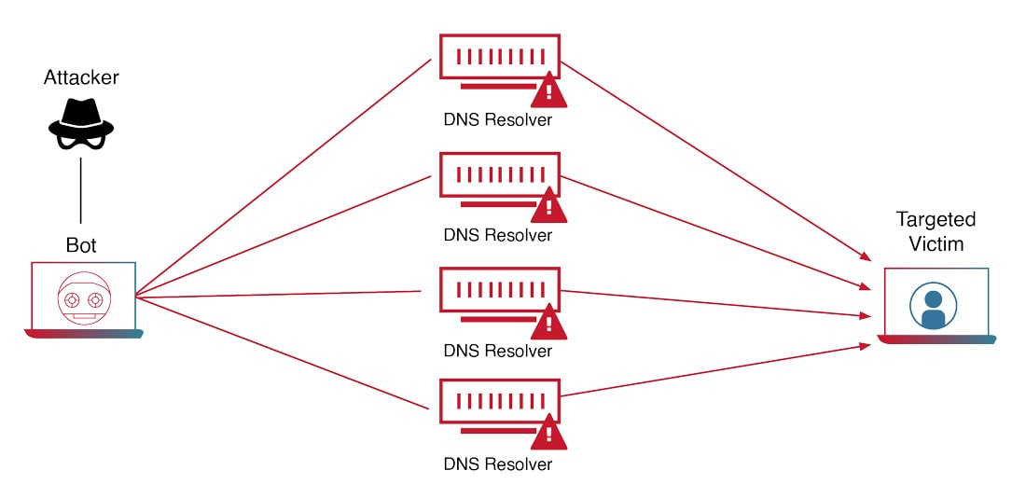
What is Denial of Service
DoS attack is a type of cyber attack that aims to disrupt the normal functioning of a website or network
A Denial-of-Service (DoS) attack is an attack meant to shut down a machine or network, making it inaccessible to its intended users.
DoS attacks accomplish this by flooding the target with traffic, or sending it information that triggers a crash.
Victims of DoS attacks often target web servers of high-profile organizations such as banking, commerce, and media companies, or government and trade organizations.

Slide 3
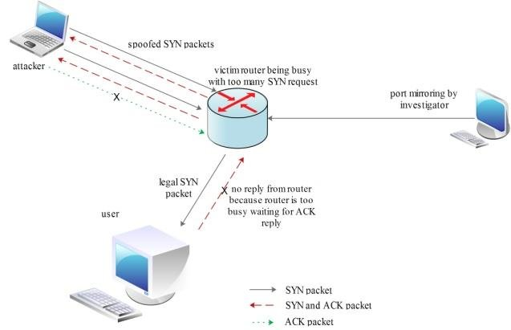
Types of DoS Attacks
DoS attacks can be classified into different types such as Buffer overflow attacks, TCP SYN flood, and ICMP flood.
Each type of DoS attack has a unique signature that can be used to identify it.

Slide 4
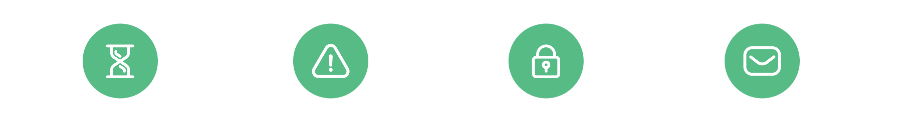
Signs of Dos attack
Degradation
in Network Performance
Especially when attempting
to open files stored on the network or when accessing websites
Specific Website Unavailable
A particular site does not open or cannot be found
Inability to Access Any Website
All websites are inaccessible on the network
High Volume of Email Spam
A higher than usual volume of spam email.

Slide 5
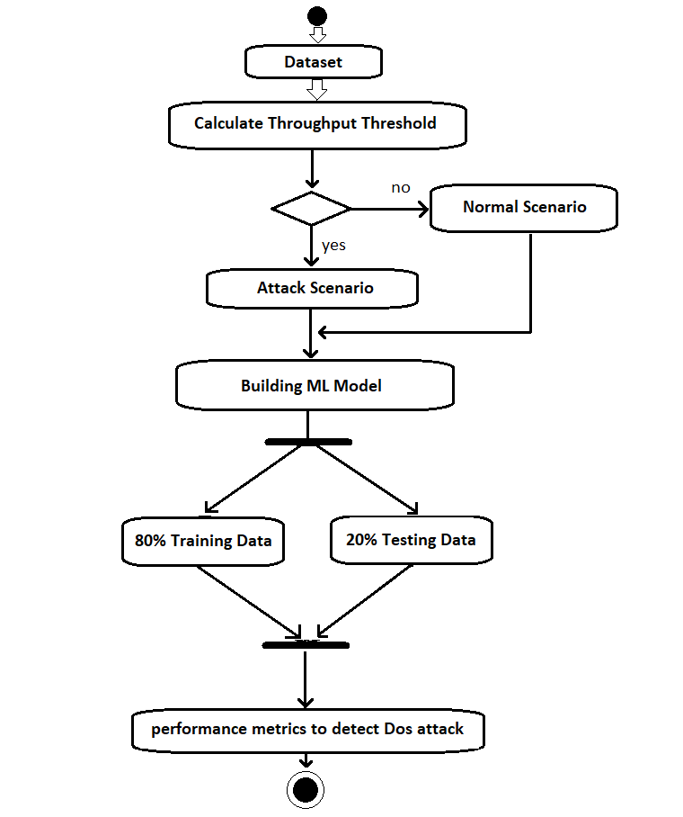
How to detect Dos using Machine Learning
A Dataset is considered as the throughput threshold.
The original dataset consisting of 29,053 records is categorized into a 80:20 ratio. That is, 80% of the data is considered as training data, and the rest of 20% of the data is test data.
machine learning models are built; In general, logistic regression is used for prediction analysis and Naive Bayes assumes conditional independence for all features.

Slide 6
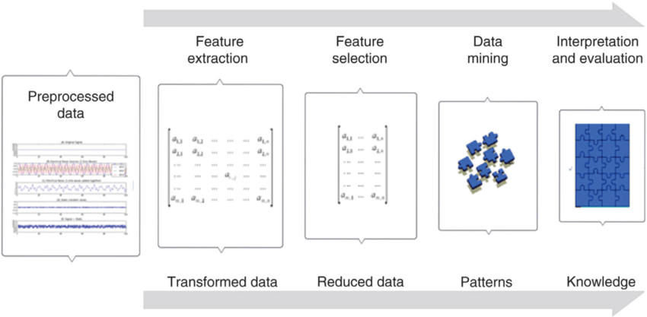
Feature Extraction
Feature extraction involves selecting the most relevant features from the data.
The selected features should be able to distinguish between normal and malicious traffic.
Feature extraction can be done manually or using automated techniques.

Slide 7
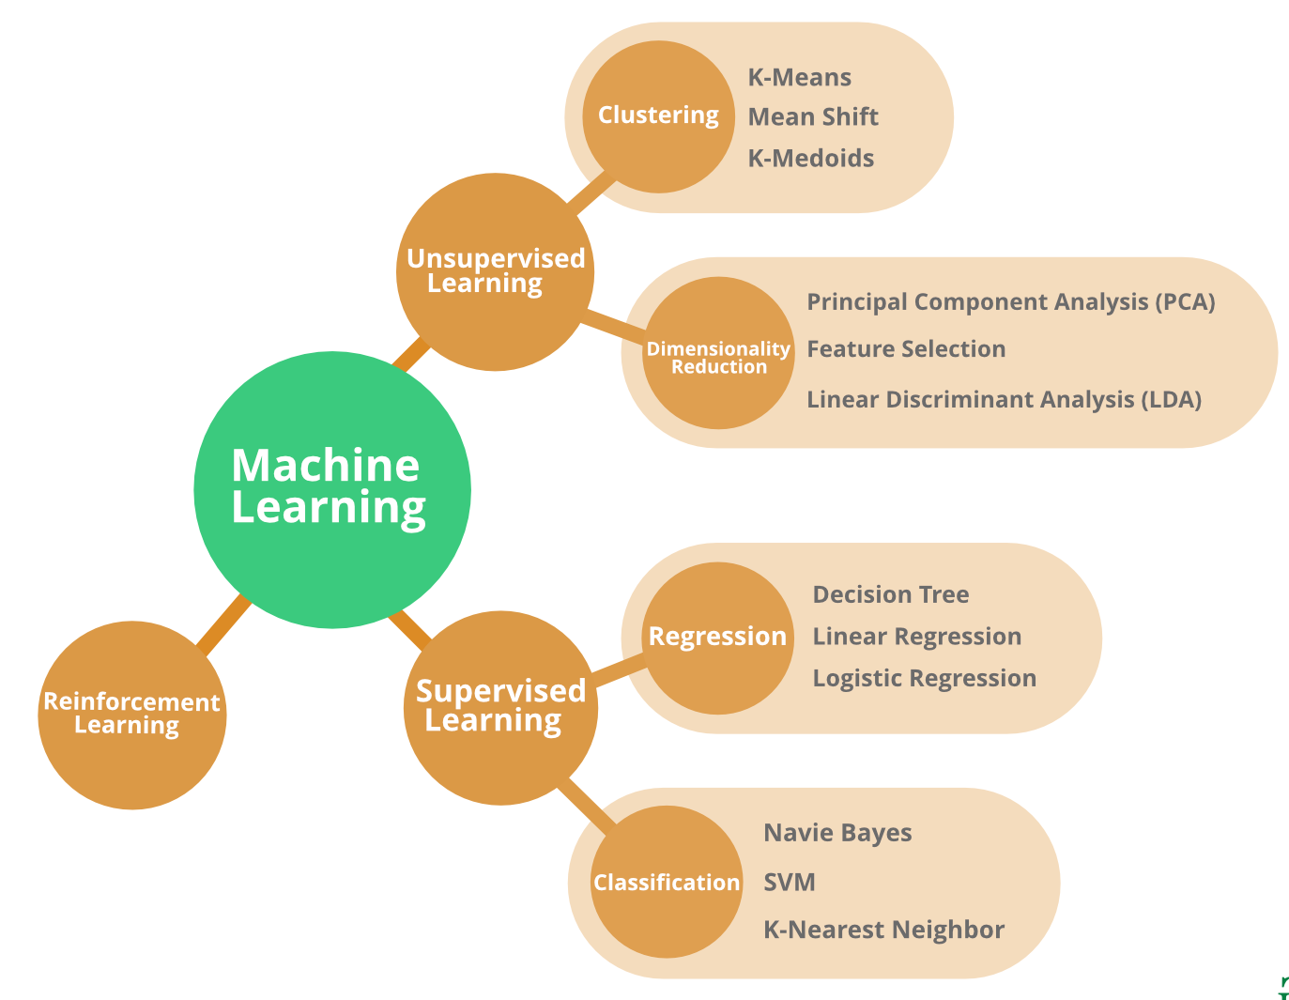
Machine Learning Algorithms
Supervised learning: In supervised learning the machine learning algorithm learns from labelled data
Unsupervised Learning: In unsupervised learning the machine learning algorithm learns from unlabelled data.
Reinforcement Learning: Reinforcement learning is an area of machine learning concerned with how intelligent agents take action in an environment to maximize its reward.

Slide 8
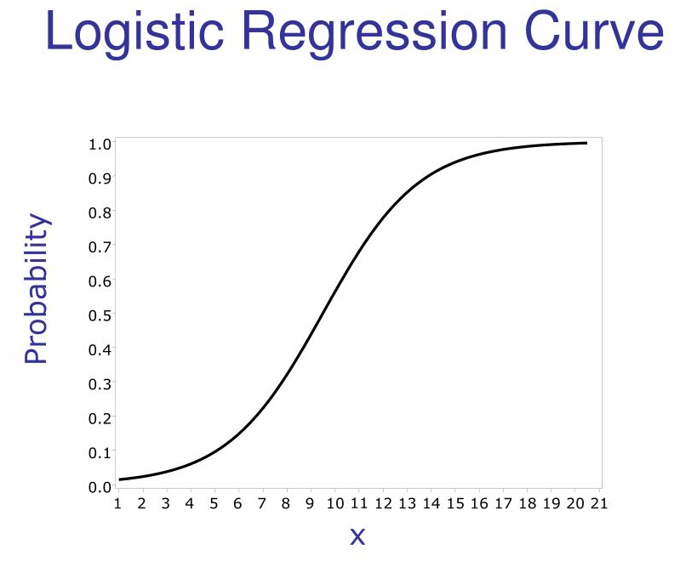
Classifier Used
Logistic regression:
Logistic regression is a supervised machine learning algorithm mainly used for classification tasks where the goal is to predict the probability that an instance of belonging to a given class or not.
It is a kind of statistical algorithm, which analyze the relationship between a set of independent variables and the dependent binary variables. It is a powerful tool for decision-making.
example email spam

Slide 9
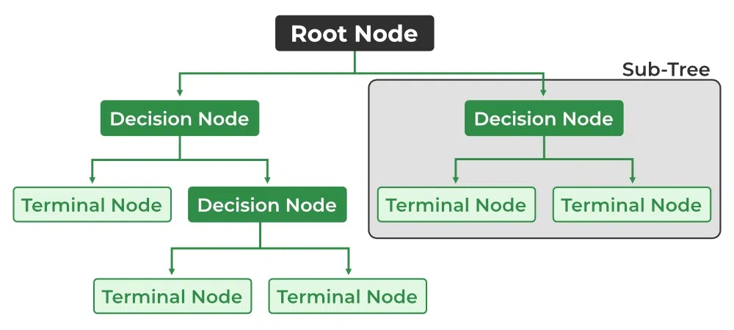
Decision Tree:
A decision tree is one of the most powerful tools of supervised learning algorithms used for both classification and regression tasks.
It builds a flowchart-like tree structure where each internal node denotes a test on an attribute, each branch represents an outcome of the test, and each leaf node (terminal node) holds a class label.
The goal is to find the attribute that maximizes the information gain or the reduction in impurity after the split.

Slide 10



Support Vector Machine:
Support Vector Machine is one of the most popular Supervised Learning algorithms, which is used for Classification as well as Regression problems.
The goal of the SVM algorithm is to create the best line or decision boundary that can segregate n-dimensional space into classes so that we can easily put the new data point in the correct category in the future. This best decision boundary is called a hyperplane.
SVM chooses the extreme points/vectors that help in creating the hyperplane. These extreme cases are called as support vectors.

Slide 11
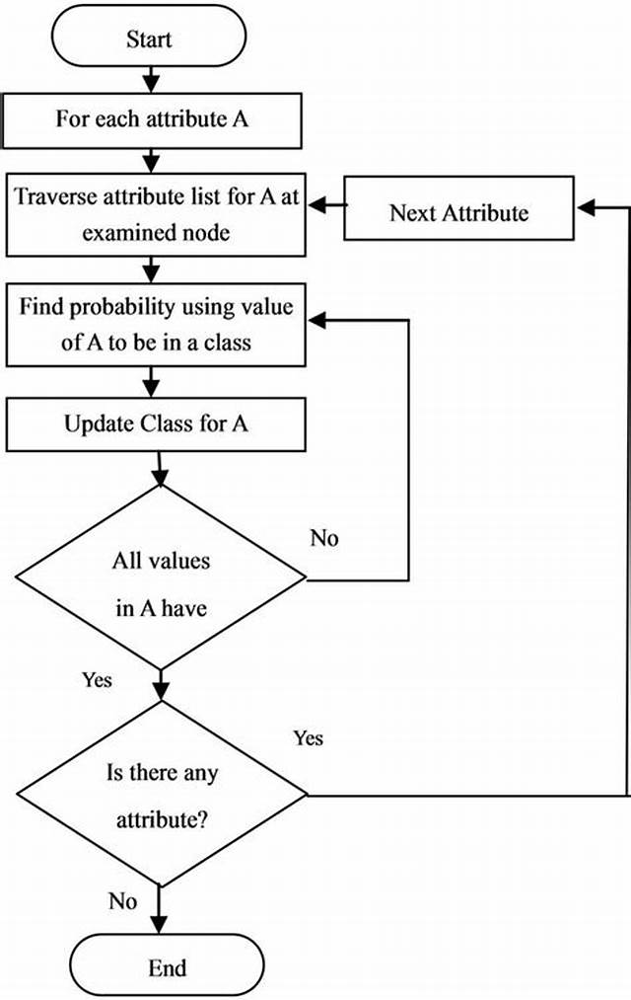
Naive Bayes:
Naive Bayes is a simple and powerful algorithm for predictive modeling.
The model comprises two types of probabilities that can be calculated directly from the training data: (i) the probability of each class and (ii) the conditional probability for each class given each x value1.
Naive Bayes is a classification technique based on an assumption of independence between predictors.
Naive Bayes classifiers are a collection of classification algorithms based on Bayes’ Theorem. It is not a single algorithm but a family of algorithms where all of them share a common principle, i.e. every pair of features being classified is independent of each other.

Slide 12
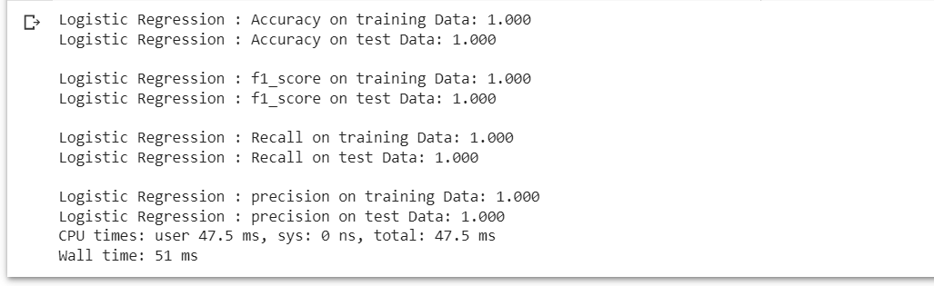
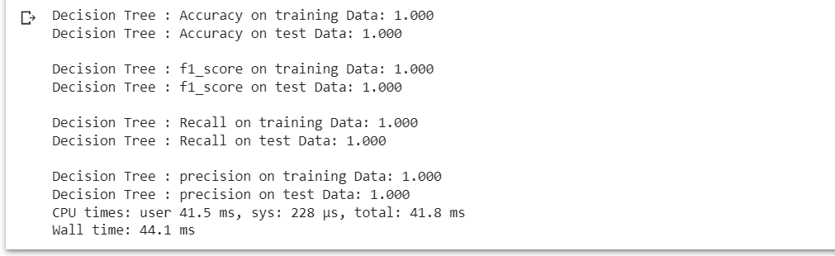
Accuracy
Logistic Regression:
Decision Tree:

Slide 13
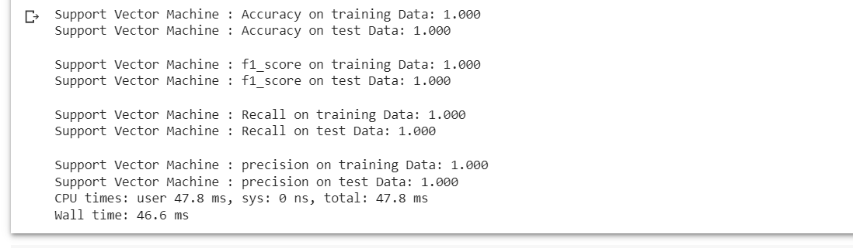
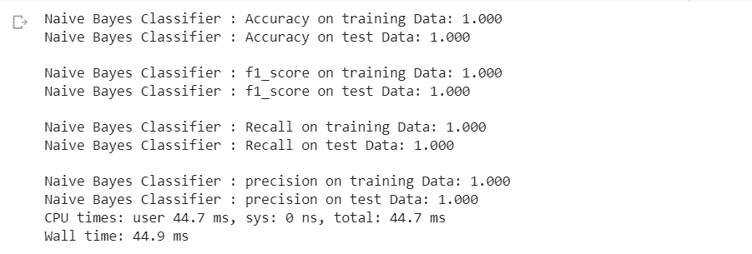
Support Vector Machine:
Naive Bayes:

Slide 14
Result and Conclusion
Upon loading the dataset, visualizing it, splitting the dataset and then training it and testing it against the various pre-existing Machine Learning classifiers as present above. It is possible to conclude that, the dataset is very clean and it is possible for all of these ML classifier algorithms to draw a line and detect if the network log is a DOS Attack or not. The metrics of the algorithms remain unchanged and also playing around with the features has not resulted in any significant change. So now the only way to pick an optimal algorithm is on the basis of run time.

Slide 15
I've calculated the average of 10 run times of each ML classifier as listed below and out of which, the most optimal algorithm is Decision Tree Classifier with an Average run time of 45.76 ms. Hence, I conclude that in the comparative study for finding the optimal algorithm for DOS Detection, in the given scenario and problem statement is the Decision Tree Classifier.

Slide 16
Thankyou!

